Slide 1
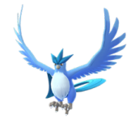
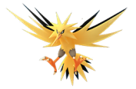
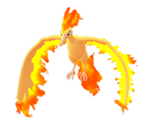
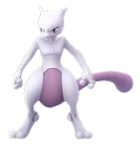
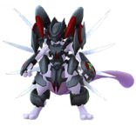
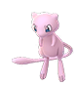
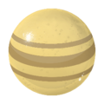

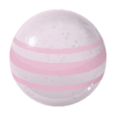
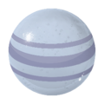
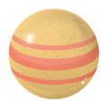
Pokemon Go
Buddy Distance Candies : Generation 1 ( Kanto ) – 20km
Articuno | Zapdos | Moltres | Mewtwo | Mewtwo (Armored) | Mew

Slide 2
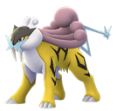
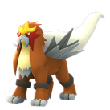
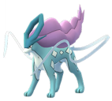
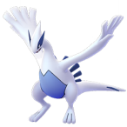
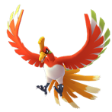
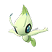
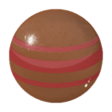
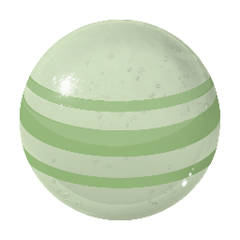
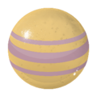
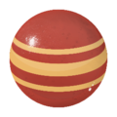

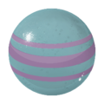
Pokemon Go
Buddy Distance Candies : Generation 2 ( Johto ) – 20km
Raikou | Entei | Suicune | Lugia | Ho-Oh | Celebi

Slide 3
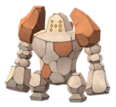
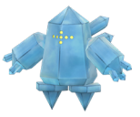
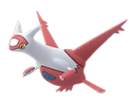
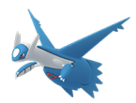
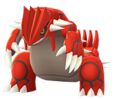
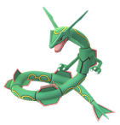
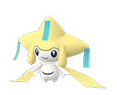
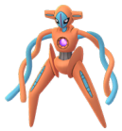

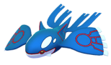
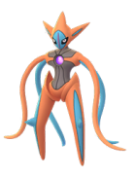
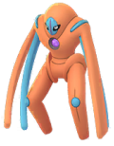
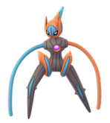
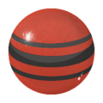

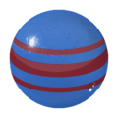
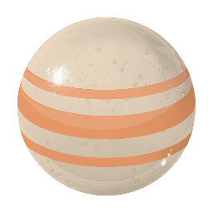

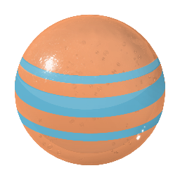
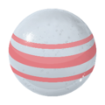
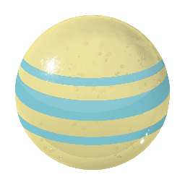
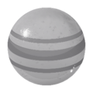
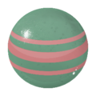
Pokemon Go
Buddy Distance Candies : Generation 3 ( Hoenn ) – 20km
Regirock | Regice | Registeel | Latias | Latios | Kyogre | Groudon | Rayquaza | Jirachi | Deoxys ( Normal )
Deoxys ( Attack ) | Deoxys ( Defense ) | Deoxys ( Speed )

Slide 4
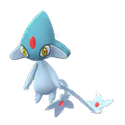


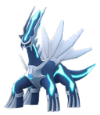
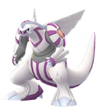
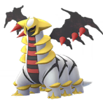
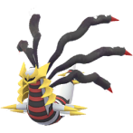
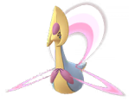
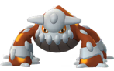
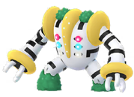


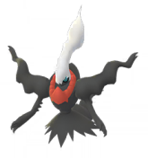





























Pokemon Go
Buddy Distance Candies : Generation 4 ( Sinnoh ) – 20km
Uxie | Mesprit | Azelf | Dialga | Palkia | Heatran | Regigigas | Giratina ( Altered ) | Giratina ( Origin ) | Cresselia
Phione | Manaphy | Darkrai | Shaymin ( Land ) | Shaymin ( Sky ) | Arceus ( Bug ) | Arceus ( Dark ) | Arceus ( Dragon ) | Arceus ( Electric ) | Arceus ( Fairy )
Arceus ( Fighting ) | Arceus ( Fire ) | Arceus ( Flying ) | Arceus ( Ghost ) | Arceus ( Grass ) | Arceus ( Ground ) | Arceus (Ice) | Arceus ( Normal ) | Arceus ( Poison ) | Arceus ( Psychic )
Arceus ( Rock ) | Arceus ( Steel ) | Arceus ( Water )

Slide 5
Pokemon Go
Buddy Distance Candies : Generation 5 ( Unova ) – 20km
? | ? | ? | ? | ? | ? | ? | ? | ? | ?
? | ? | ? | ? | ? | ? | ? | ? | ? | ?
? | ? | ? | ? | ? | ? | ? | ? | ? | ?
? | ? | ? | ? | ? | ? | ? | ? | ? | ?
? | ? | ? | ? | ? | ? | ? | ? | ? | ?

Slide 6
Pokemon Go
Buddy Distance Candies : Generation 6 ( Kalos ) – 20km
? | ? | ? | ? | ? | ? | ? | ? | ? | ?
? | ? | ? | ? | ? | ? | ? | ? | ? | ?
? | ? | ? | ? | ? | ? | ? | ? | ? | ?
? | ? | ? | ? | ? | ? | ? | ? | ? | ?
? | ? | ? | ? | ? | ? | ? | ? | ? | ?

Slide 7
Pokemon Go
Buddy Distance Candies : Generation 7 ( Alola ) – 20km
? | ? | ? | ? | ? | ? | ? | ? | ? | ?
? | ? | ? | ? | ? | ? | ? | ? | ? | ?
? | ? | ? | ? | ? | ? | ? | ? | ? | ?
? | ? | ? | ? | ? | ? | ? | ? | ? | ?
? | ? | ? | ? | ? | ? | ? | ? | ? | ?

Slide 8



Pokemon Go
Buddy Distance Candies : Generation 8 ( Galar ) – 20km
Meltan | Melmetal

